Slide 1
Meshes网格
Polygonal meshes are the standard method for defining and displaying surfaces
  Directly from CAD packages
  Subdivision
  Approximations to curved surfaces
Most common are quadrilateral and triangular meshes(四边形和三角形网格）
  Triangle strips and Triangle fans
Notes:
*
1999年7月07/16/96
*
<number>##

Slide 2
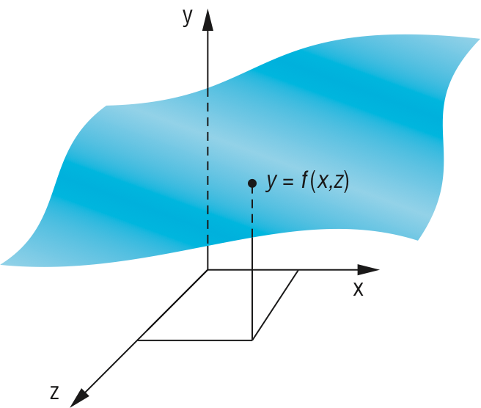
Height Fields高程数据场
For each (x, z) there is a unique y
Sampling leads to an array of y values
Display as quadrilateral or triangular mesh using strips（分割）
Notes:
Old 2D method uses fact that data are ordered and we can render front to back
Regard each plane of constant z as a flat surface that can block (parts of) planes behind it
Can proceed iteratively maintaining a visible top and visible bottom
Lots of little line intersections
Lots of code but avoids all 3D
*
1999年7月07/16/96
*
<number>##

Slide 3
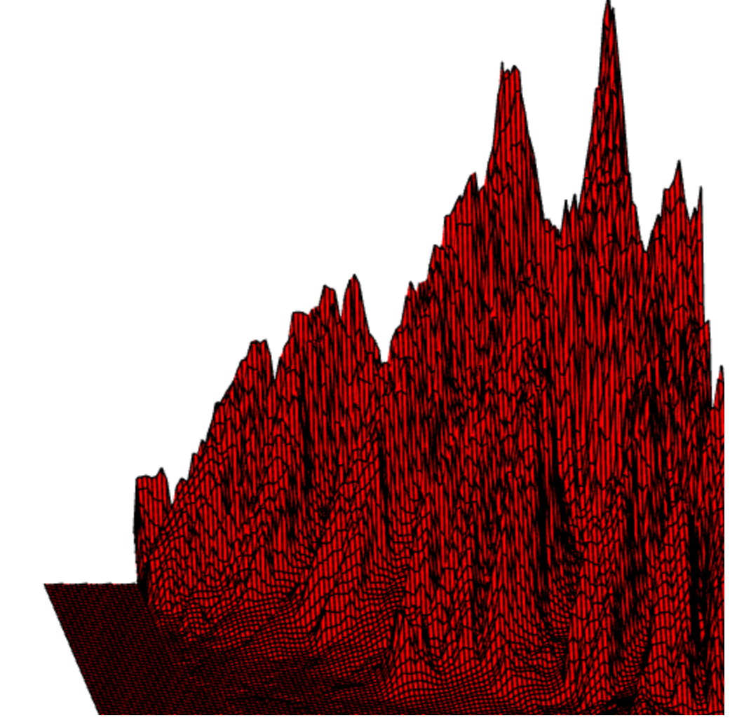
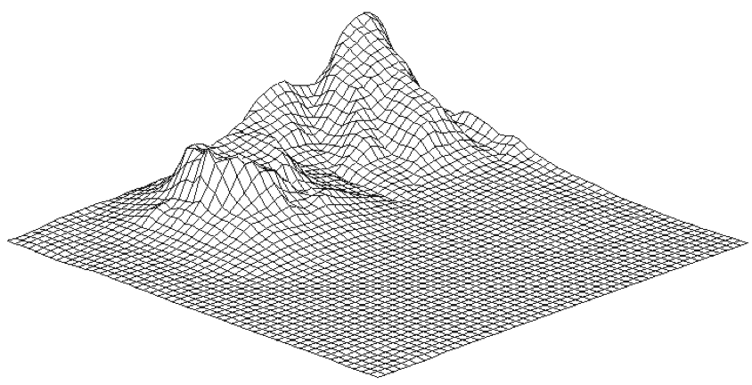
一.Honolulu –夏威夷火山
(Z,X,Y),其中y是高程数据
Y
Z
X
Honolulu Plot Using Line Strips
Notes:
*
1999年7月07/16/96
*
<number>##

Slide 4

1.确定顶点坐标Z,X
(0,0),(nRow,nColomn)规约到(-1,-1)(1,1)正方形中。
  变换矩阵：T(-1,-1)*S(2/nColumns, 2/nRows),
  结果：Zi=2*i/nColumns-1, , Xj=2j/nRow-1
(0,0)
X
(-1,-1)
X
(1,1)
Z
(nColumns,nRows)
Z

Slide 5
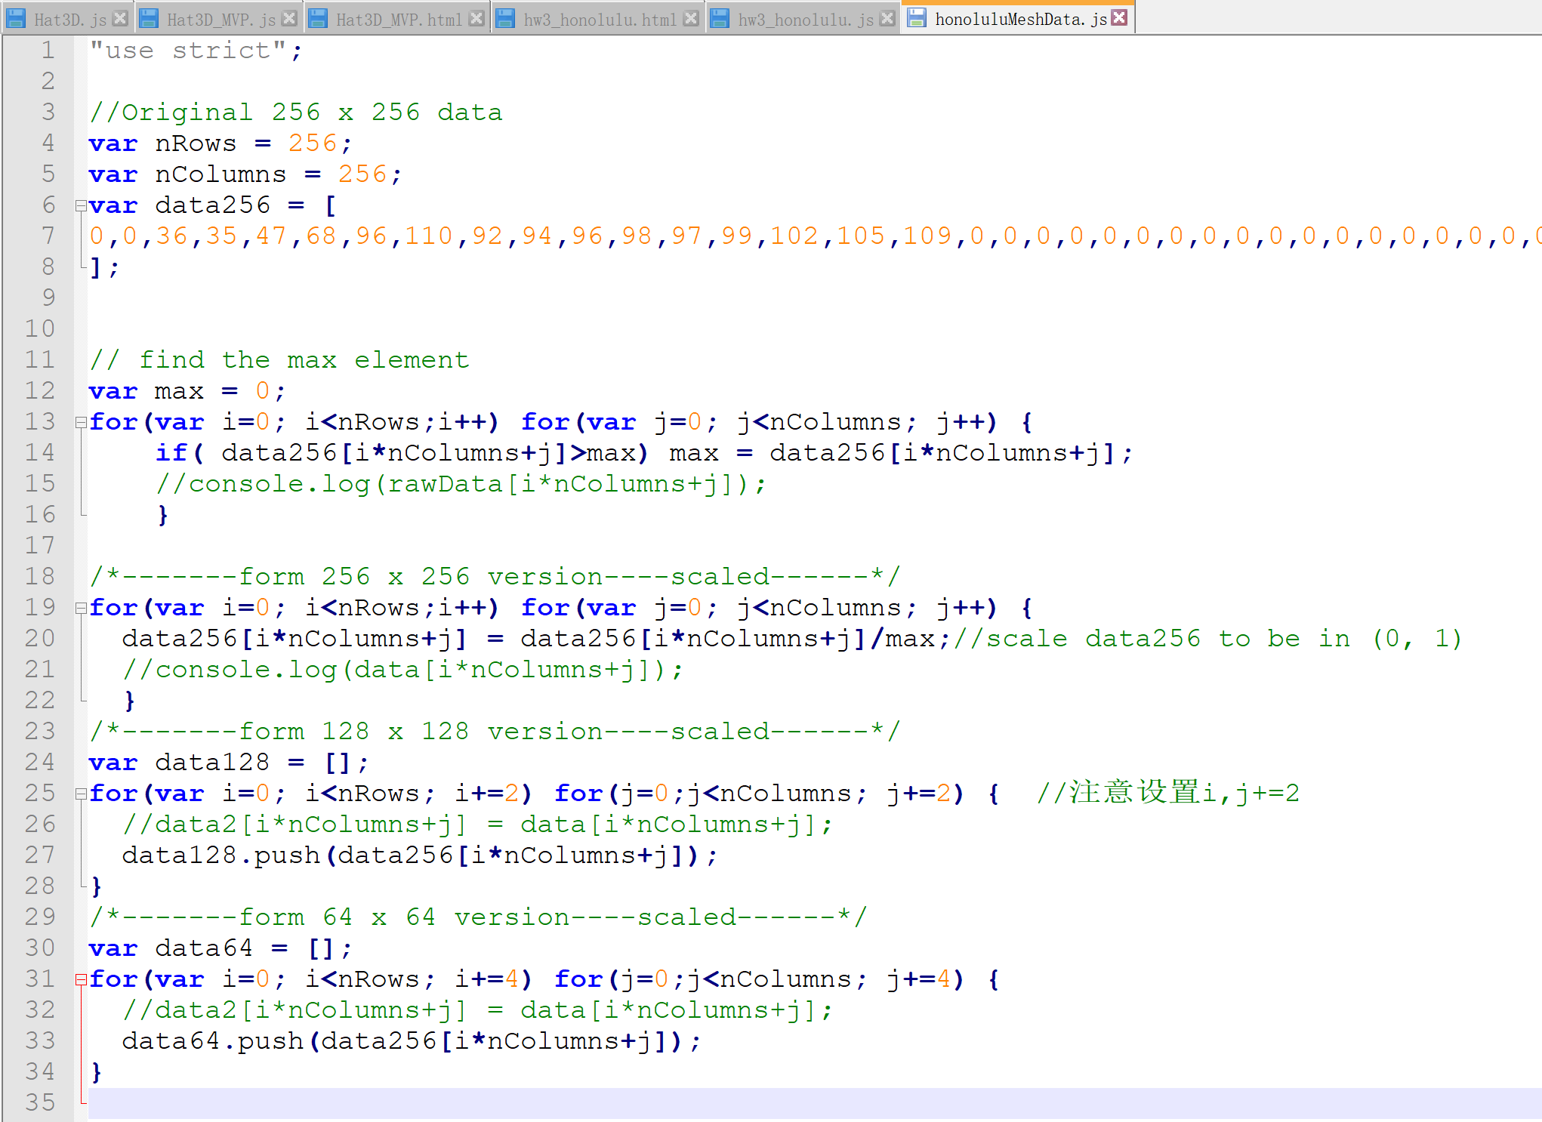
2.确定顶点坐标Y
从文件读取：HonoluluMeshData.js
  原始高度数据值存放在数组data256
  使用前，先把高程值规约到0..1范围
  本例采用三种分辨率数据data256,data128,data64

Slide 6
渲染采用的图元
use four adjacent data points to form a quadrilateral and thus two triangles which can be shaded,to see the grid
display each quadrilateral twice
  First as two filled white triangles
  Second as a black line loop
GL_TRIANGLE_FAN
GL_LINE_LOOP
Hat Using Triangles and Lines

Slide 7
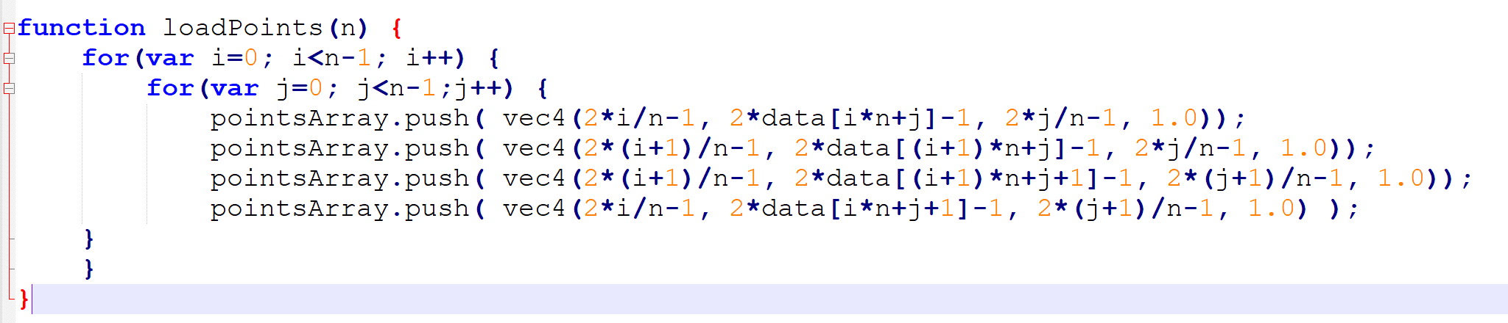
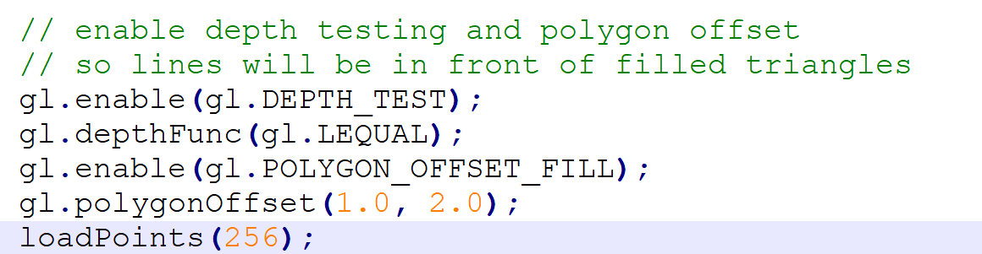
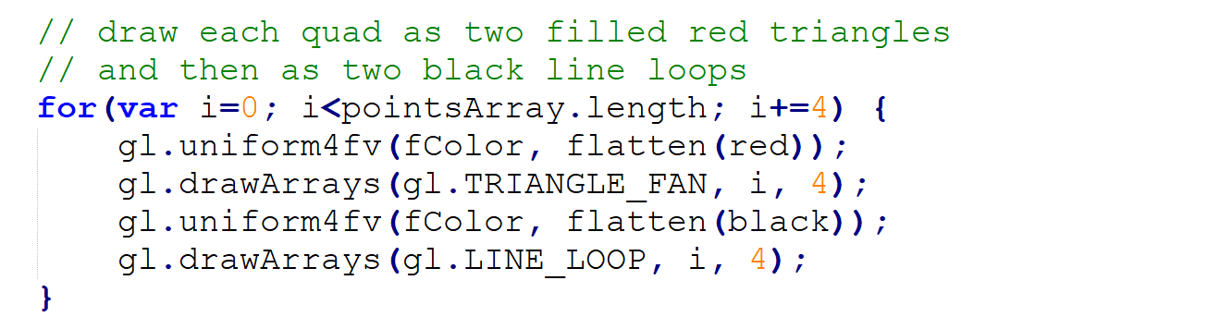
3.渲染图形（面图元+边框）
以每个格子(四边形/四个顶点)作为绘制单元传送数据
Render中绘制每个格子颜色和边框
Notes:
*
1999年7月07/16/96
*
<number>##

Slide 8
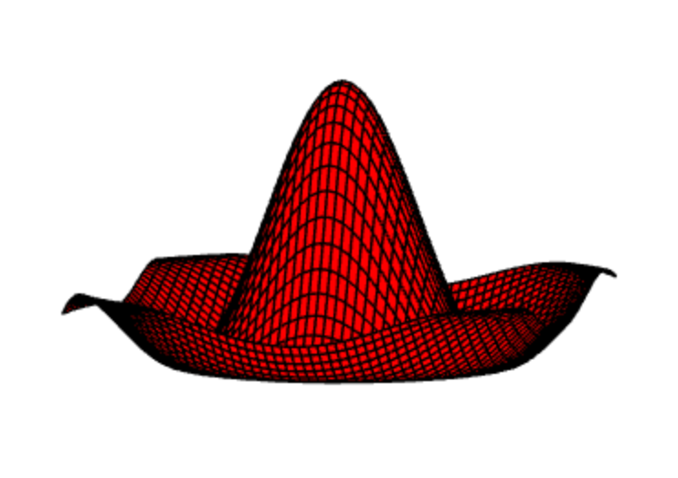
二.sombrero or Mexican hat
需要计算高程：y=f(z,x),
sombrero or Mexican hat function (sin πr)/(πr)计算高度
r=sqrt(x*x, z*z)
y=(sin πr)/(πr), r!=0,
y=1, r=0
hat(面图元+边框）

Slide 9
1.确定顶点坐标Z,X
(0,0),(nRow,nColomn)规约到(-1,-1)(1,1)正方形中
变换矩阵：T(-1,-1)*S(2/(nColumns-1), 2/(nRows-1)),
  Zi=2*i/(nColumns-1)-1,
  Xj=2j/(nRow-1)-1
(0,0)
X
(-1,-1)
X
(1,1)
Z
(nColumns,nRows)
Z
Notes:
注意：长和宽应该是(nColumns-1),如：ncolumns=5,实际长度为5-1=4
*
1999年7月07/16/96
*
<number>##

Slide 10
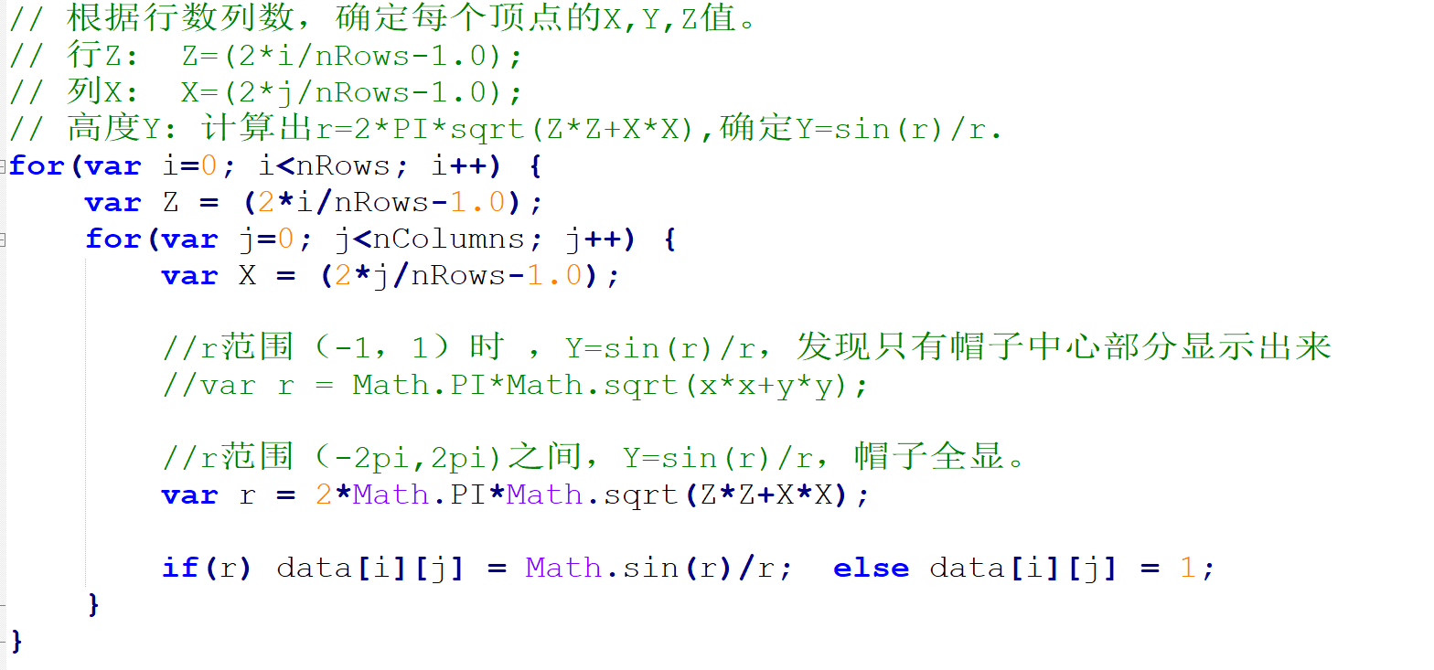
2.计算顶点坐标Y值-存data中
function y=(sin r)/(r) 存放在data数组中
  r=2π*sqrt(x*x, z*z)，
  r!=0： y=sin（r）/r
  r=0： y=1
Notes:
*
1999年7月07/16/96
*
<number>##

Slide 11
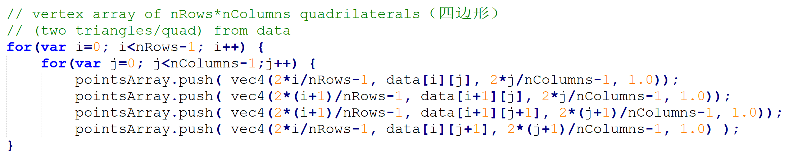
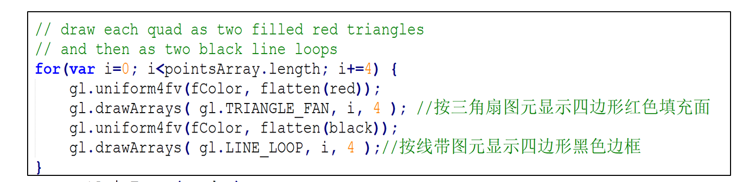
3渲染(面图元+边框)hat.js
图形网格基本单位是四边形，
而每个四边形用两个三角形绘制
本例除了填充四边形面颜色，还绘制了四边形边框
Notes:
*
1999年7月07/16/96
*
<number>##

Slide 12
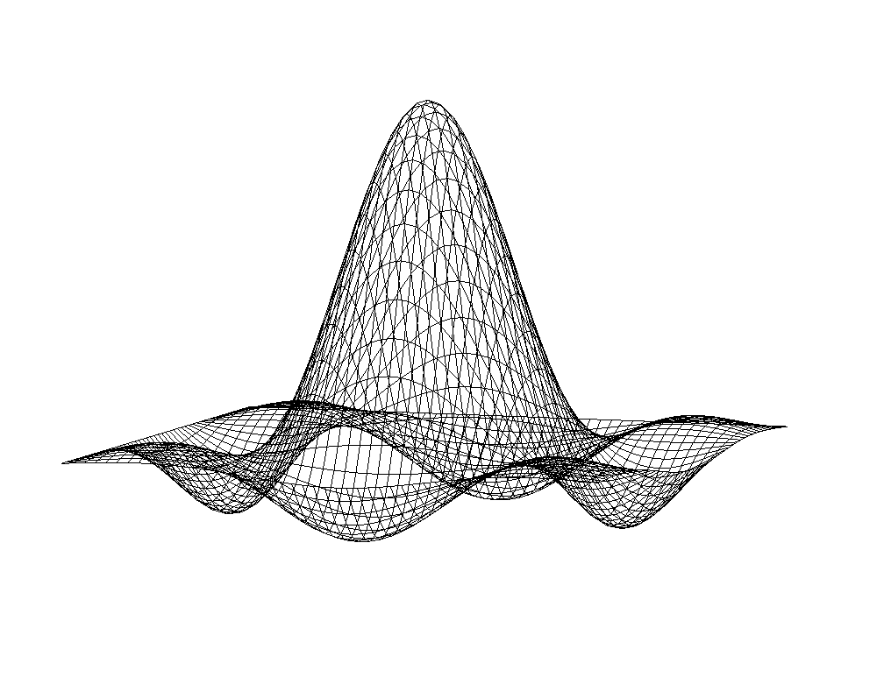
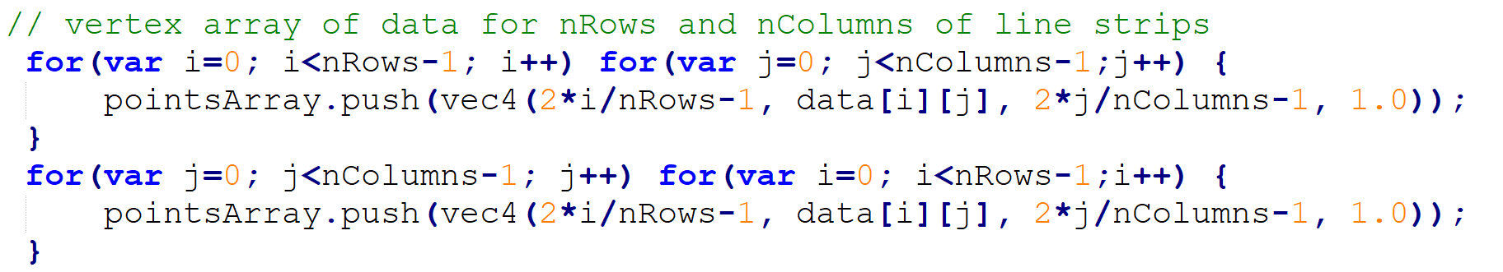
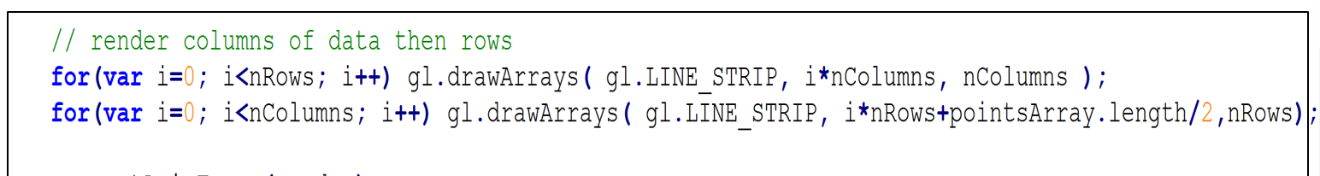
3’ 其它渲染(线图元):hata.js
将nRows*nColumn个顶点位置数据放入pointAarray数组,
先放行线顶点，后放列线顶点
图元是 line_strip。每行线，每列线 都是一个line_strip图元
GL_LINE_STRIP

Slide 13
Other Mesh Issues
How to construct a mesh from disparate（不相干的） data (unstructured points)
  Technologies such as laser scans can produced tens of millions of such points
  Chapter 12: Delaunay triangulation(狄洛尼三角剖分/德劳内三角化)
Notes:
Can we use one triangle strip for an entire 2D mesh?
laser scans激光扫描
Mesh simplification
*
1999年7月07/16/96
*
<number>##

